Slide 1
Wkdatasolve
Final Presentation
Team YS: Xinze Yu, Aiwu Song
Nov. 15, 2022

Slide 2
This task can be generally divided into four parts:
1. Data exploring and preprocessing;
01
2. Convert text information into ‘readable’ information that can be processed by a computer, which can also be called natural language processing(NLP);
02
3. Construct and select an appropriate model for training;
03
4. Apply test data to make predictions.
04

Slide 3
Data preprocessing

Slide 4

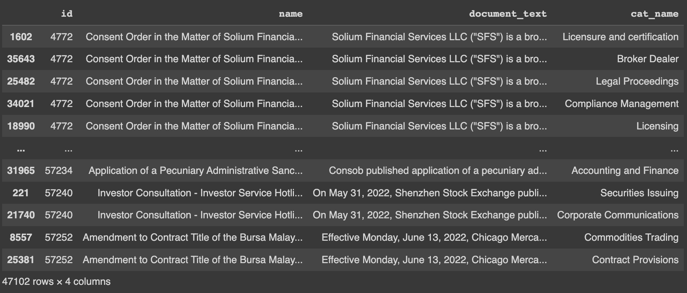
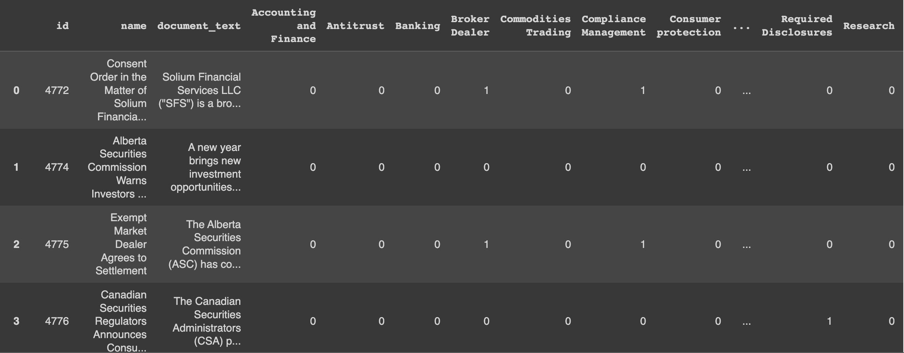
Data Exploring & Preprocessing
Only the category corresponding to each regulation is recorded (no non-corresponding categories are recorded), which is very inconvenient for our subsequent data analysis, so we use One-hot code to clearly indicate the category that regulation belongs to or does not belong to. (1 means belonging to this category, 0 means not belonging)

Slide 5
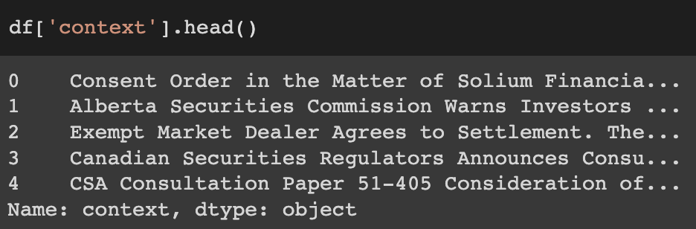
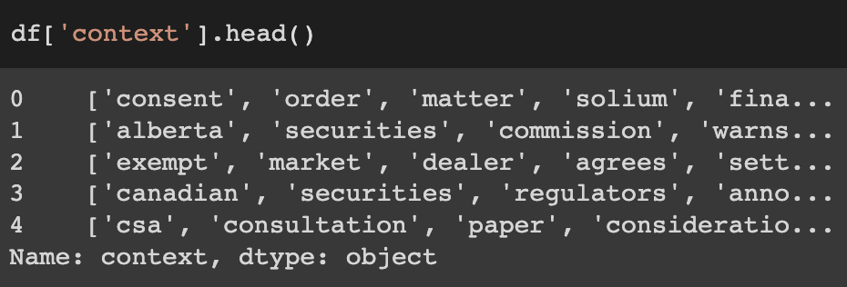
Data Exploring & Preprocessing
For the text part, we first clean the text, removing all none-character text;
Then we remove all stop words like “in”, “to” , etc.
Last we split the text into single word.
Raw data
Cleaned data

Slide 6

NLP methods
1. Bag of words model
2. TF-IDF vectorizer
3. pretrained tokenizer(Bert, genism word2vec)
4. custom tokenizer(genism word2vec)
For all the ’title’ and ‘document_text’ texts, we simply add them together as our text input.

Slide 7
Model 1: Bag of Words + MLP network

Slide 8

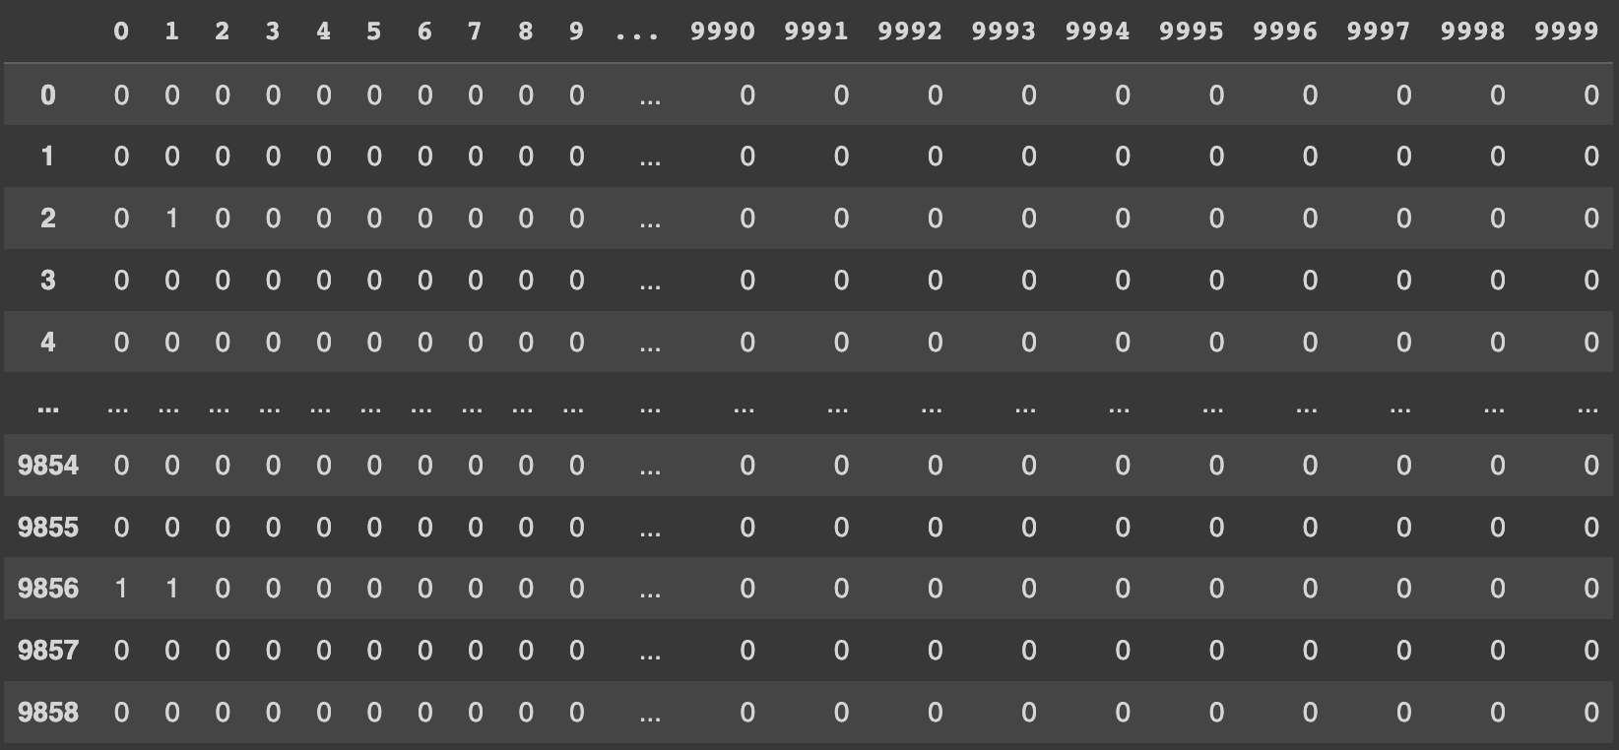
Bag of words + MLP Network
We build a bag of words model with 10,000 features and set 3 as the minimum frequency and 60% as maximum frequency.
Here is the bag of words features we are going to use in the MLP network

Slide 9
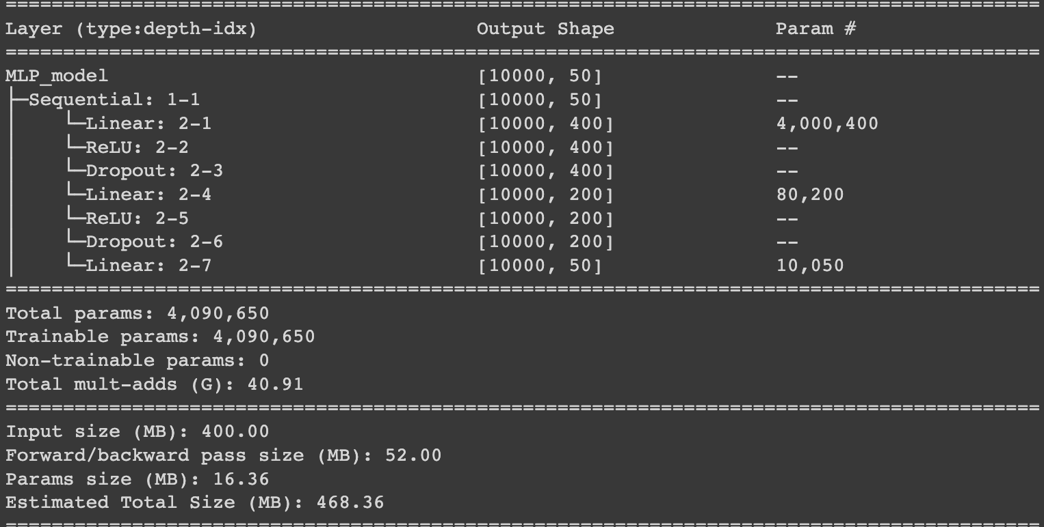
MLP Network
We build a MLP model with 2 hidden layers one have 400 units and the second one have 200 units with dropouts.
Since we have 50 labels, so the output shape is 50.

Slide 10
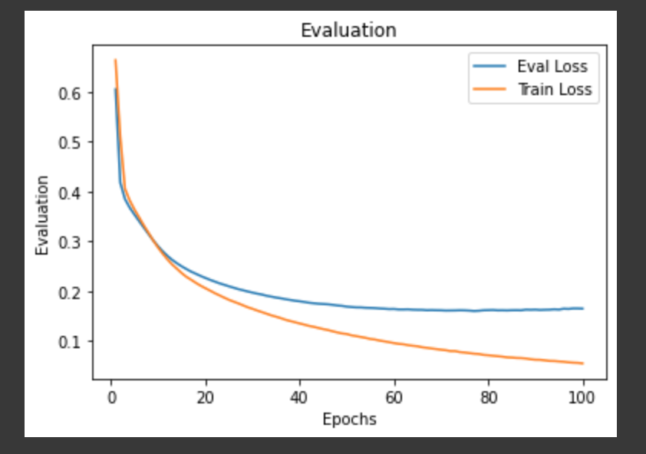
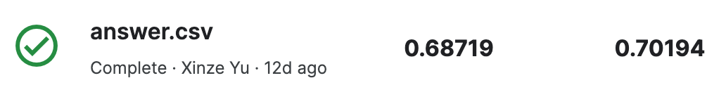
Bag of words + MLP Network
We trained 100 epochs, and the evaluation loss is no longer decrease at around 0.160.
The test accuracy for this model is 0.70194

Slide 11
Model 2: TF-IDF + ovr classifier

Slide 12
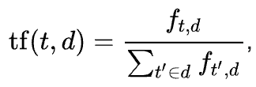
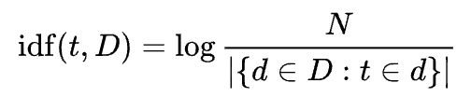
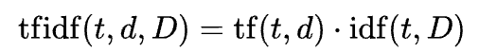

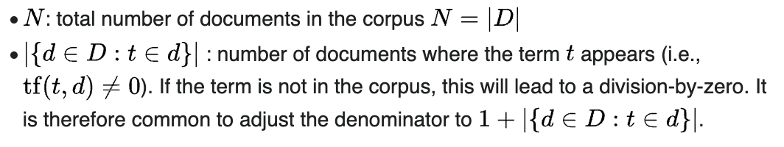
TF-IDF
Term Frequency–Inverse Document Frequency
The TF-IDF value increases proportionally to the number of times a word appears in the document and is offset by the number of documents in the corpus that contain the word.

Slide 13
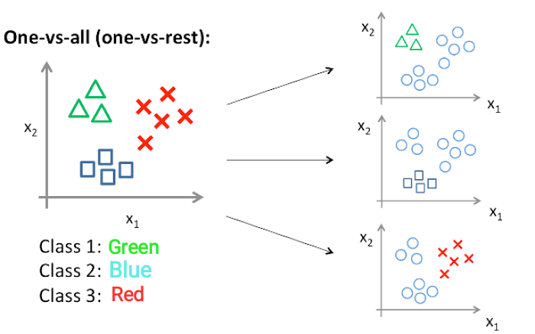
One Vs Rest Classifier
If we want to do multilabel classification, we should think about One Vs Rest Classifier. For each classifier, the class is fitted against all the other classes. (It is pretty clear, and it means that problem of multilabel classification is broken down to multiple binary classification problems).

Slide 14
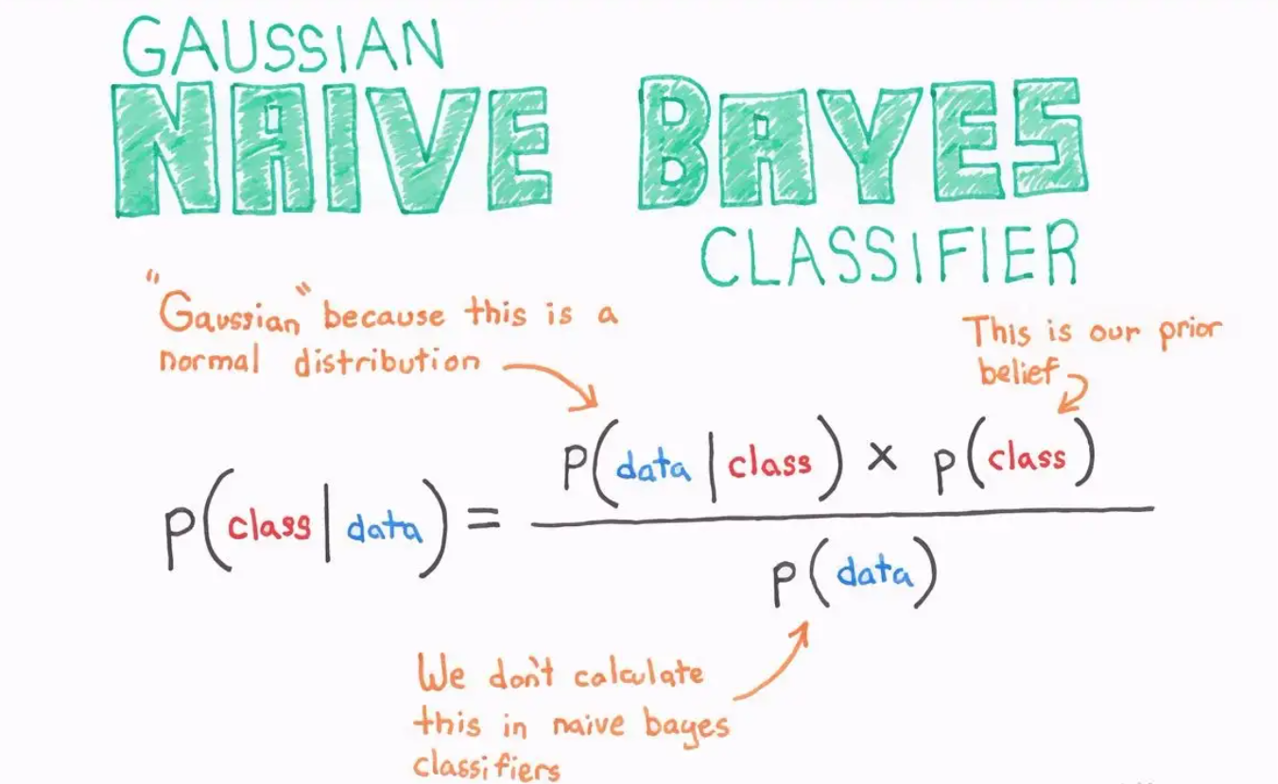
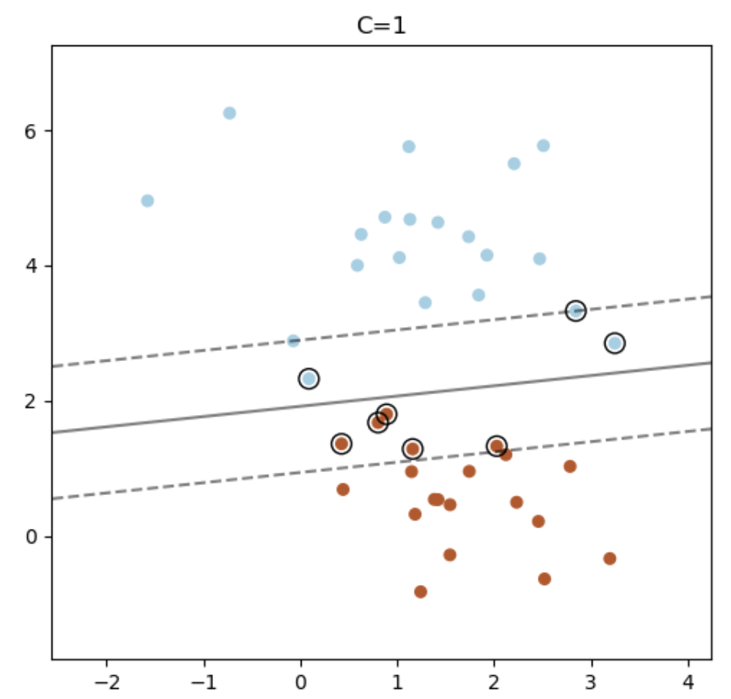
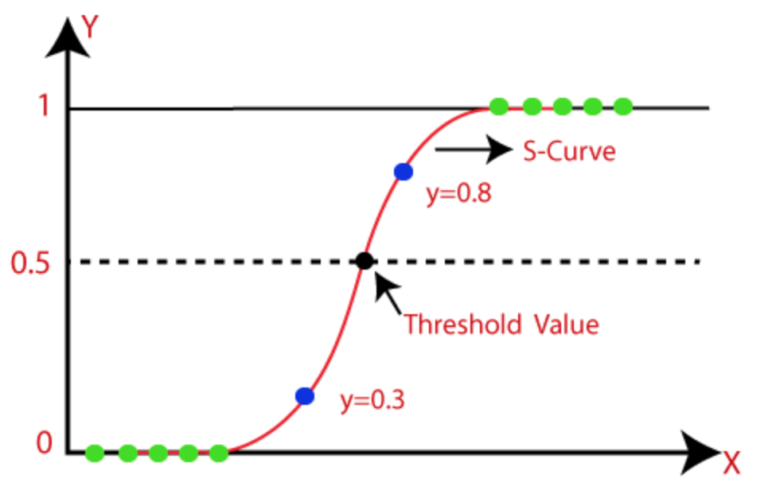
One Vs Rest Classifier
We have tried 3 models using this classifier, Naïve Bayes, Logistic Regression and Linear SVC(Support Vector Classifier).

Slide 15
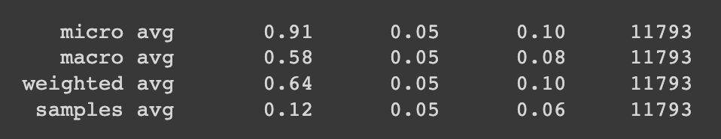

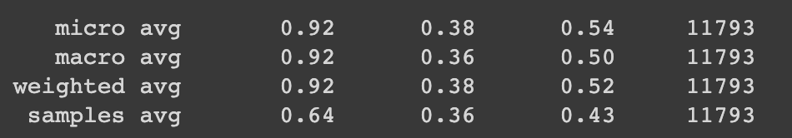
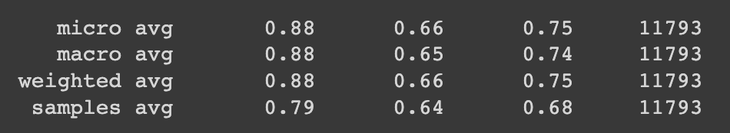
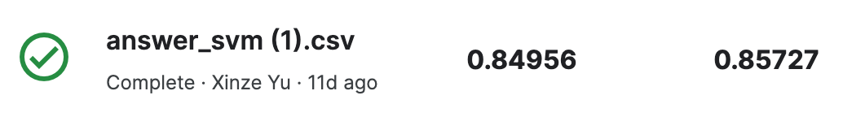

TF-IDF + One Vs Rest Classifier
Classification reports
Among these 3 methods, we can see that Naïve bayes and logistic regression have really poor performance, and Linear SVC have a relatively good performance and its final test accuracy is 0.85727
Naïve Bayes
Logistic Regression
Linear SVC

Slide 16
Model 3: Pretrained Bert tokenizer & model

Slide 17
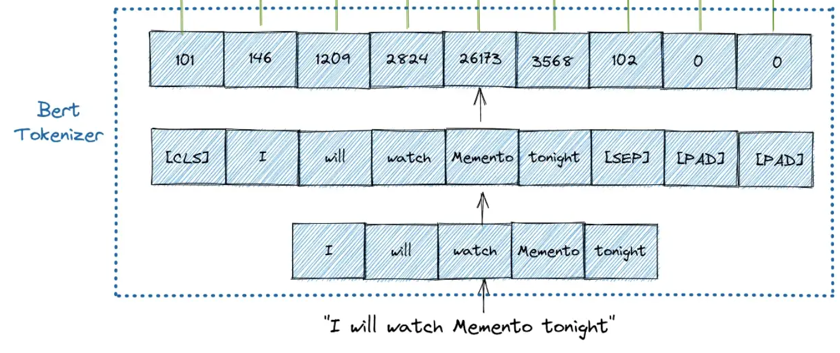
Pretrained Bert tokenizer
BERT stands for Bidirectional Encoder Representations from Transformers.
There are three special tokens for Bert model, [CLS], [SEP], [PAD].
[CLS]:This is the first token of every sequence, which stands for classification token. [101]
[SEP]: This is the token that makes BERT know which token belongs to which sequence. This special token is mainly important for a next sentence prediction task or question-answering task. If we only have one sequence, then this token will be appended to the end of the sequence. [102]
[PAD]: It is also important to note that the maximum size of tokens that can be fed into BERT model is 512. If the tokens in a sequence are less than the maximum size, we can use padding to fill the unused token slots with [PAD]. [0]

Slide 18
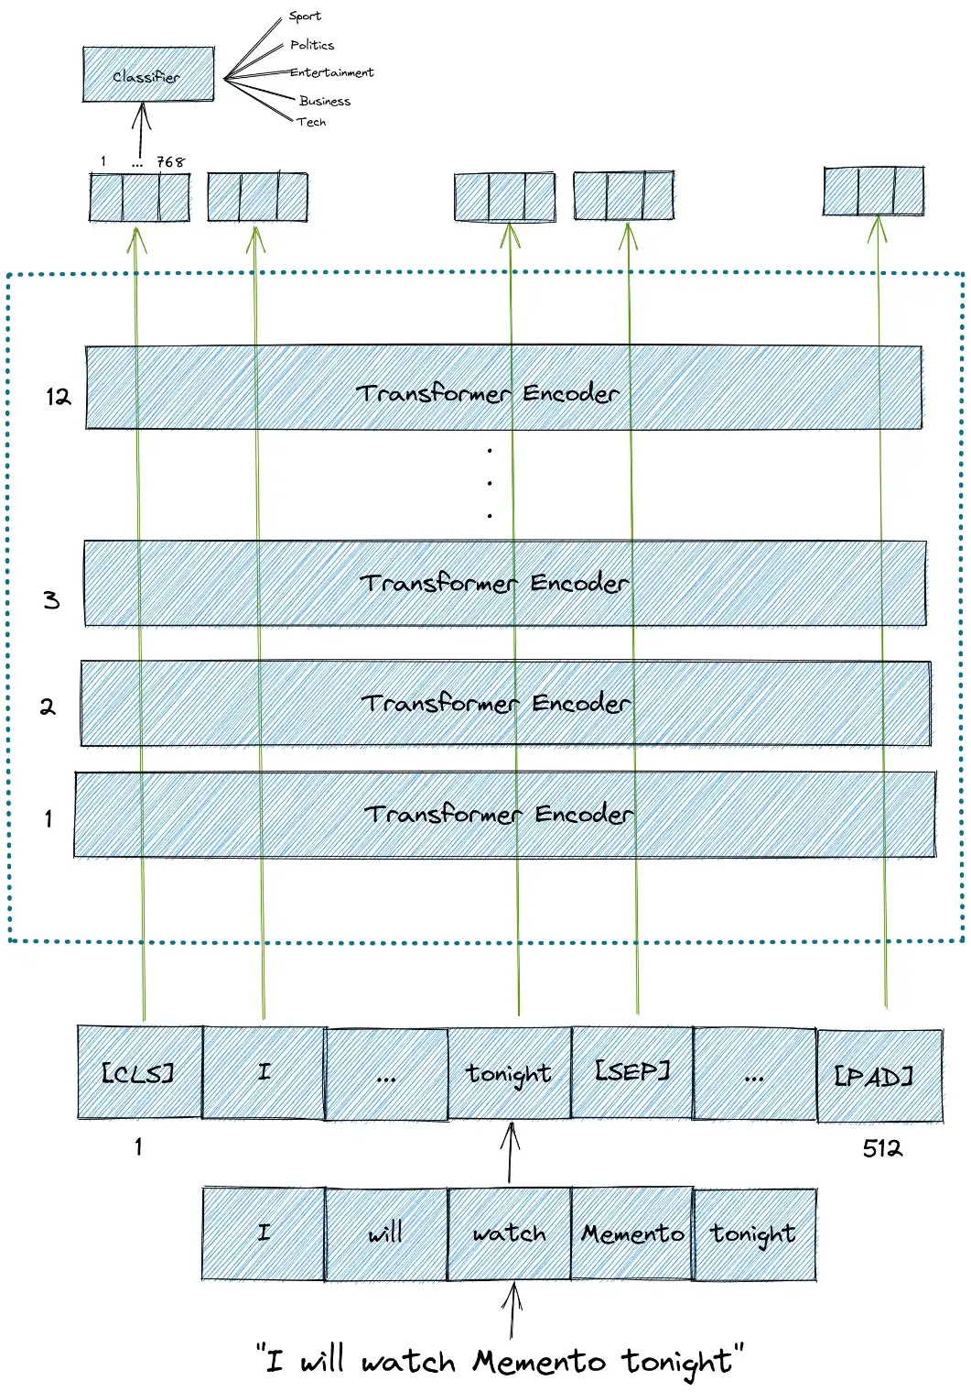
Pretrained Bert model
BERT model then will output an embedding vector of size 768 in each of the tokens.
We only take the first output of Bert model for classifier input.

Slide 19

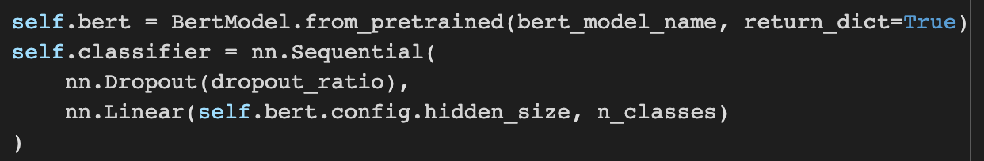
Pretrained Bert model
Since we don’t have much data for us to train, so we use the ‘bert-base-cased’ tokenizer to process our text.
Except the 12 Bert hidden layers, we add a classifier layer at the and to covert bert output into our target output.

Slide 20
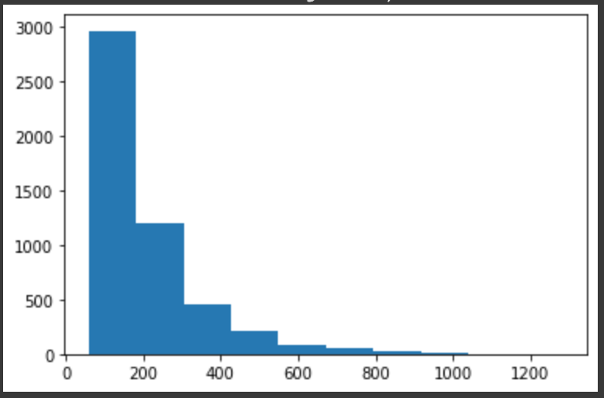
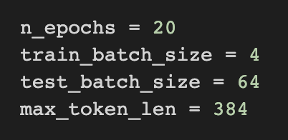
Pretrained Bert model
From the histogram we can see that most documents have a length less than 400. So we take 384 as our max token length. And since there are lots of parameters in the Bert model, we choose a small train batch size to avoid running out of GPU.

Slide 21
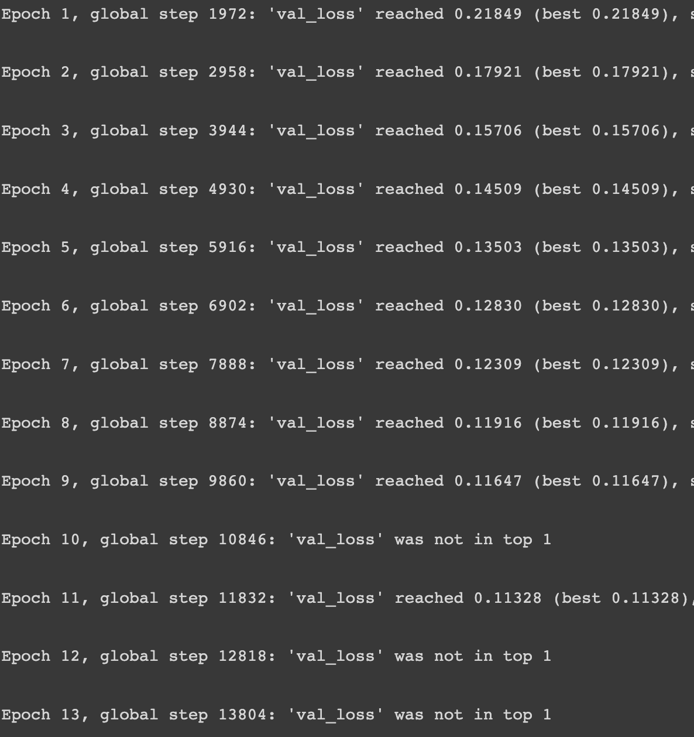
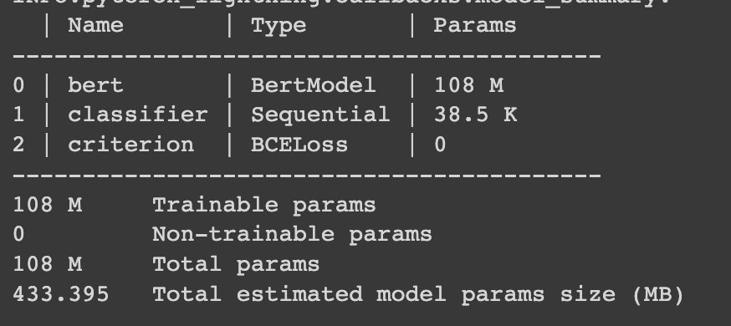
Pretrained Bert model
In the first train round, we allow all the parameters be trainable and after a few hours(14 epochs) we got a pretty good evaluation loss: 0.11328

Slide 22
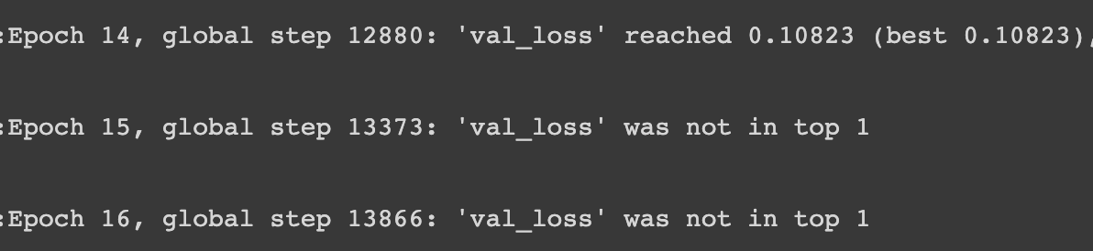
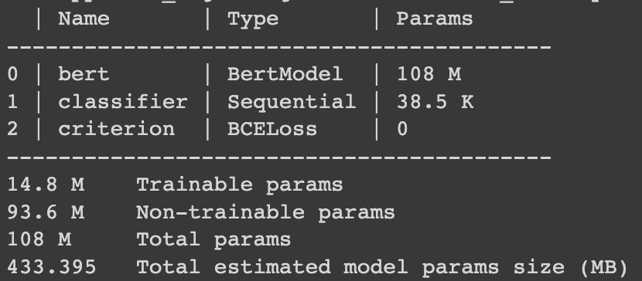
Pretrained Bert model
In the second round, we continued our train and only allow layer10 and layer 11 from Bert model and classifier layer parameters be trainable and after 4 epochs, we got a better evaluation loss: 0.10823

Slide 23
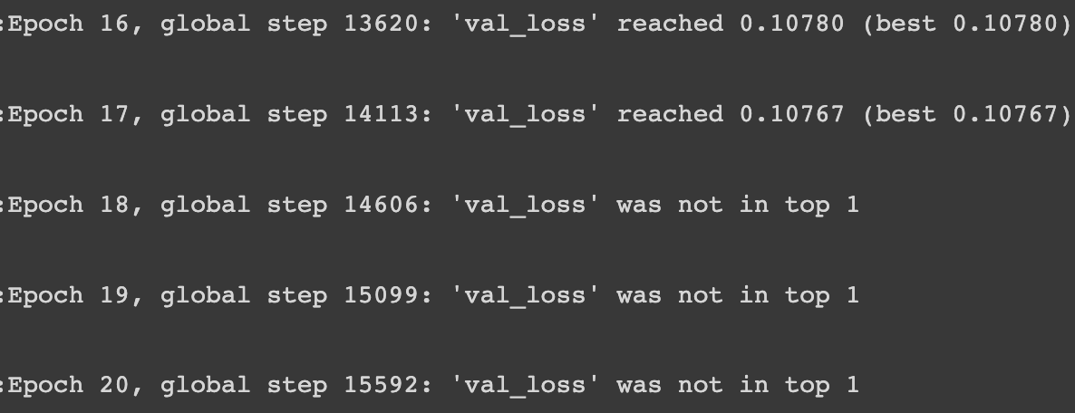
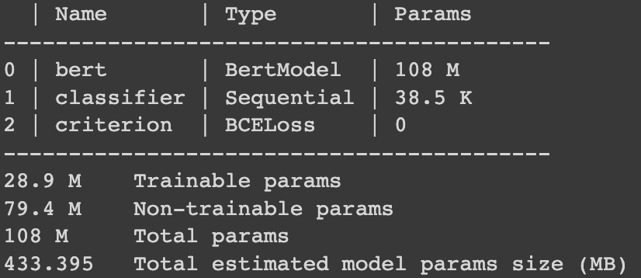
Pretrained Bert model
In the third round, we continued our train and only allow layer 7, layer8 and layer 9 from Bert model and classifier layer parameters be trainable and after 6 epochs, we got a better evaluation loss: 0.10767

Slide 24
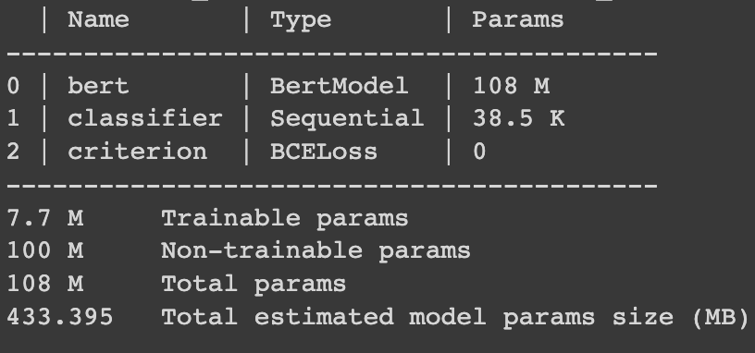
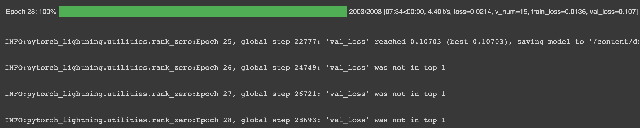
Pretrained Bert model
After a few rounds, we got the best evaluation loss: 0.10703 at epoch 25

Slide 25
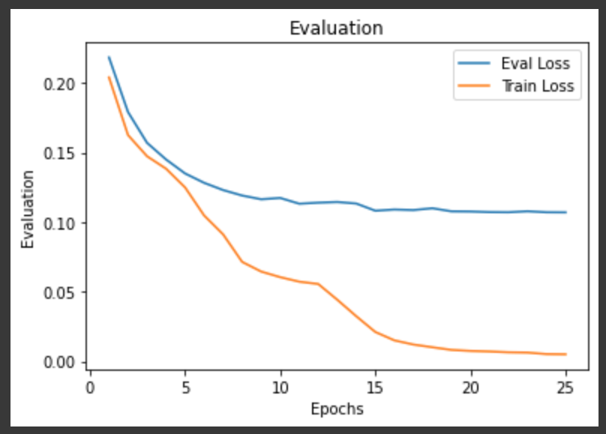
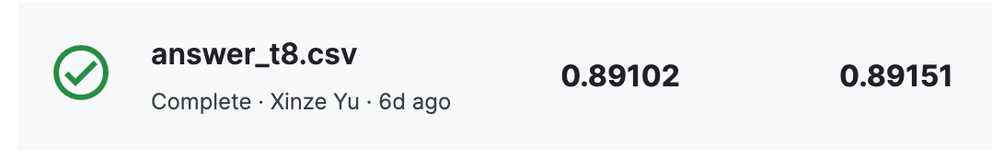
Pretrained Bert model
We trained in total 25 epochs, and the evaluation loss is no longer decrease at around 0.010703
And its final test accuracy is 0.89151

Slide 26

Mid stage Thoughts and doubts
As the best model under the existing conditions, pretrained Bert model should run a relatively good result, but why can't the accuracy of our model reach 0.9?
So we took a look at the hint given by the experts on Kaggle, suggesting that we should customize our embedding layer, so we tried using gensim word2vec to train a new customized model.

Slide 27
Model 4: Custom word2vec tokenizer & Convolutional neural network

Slide 28
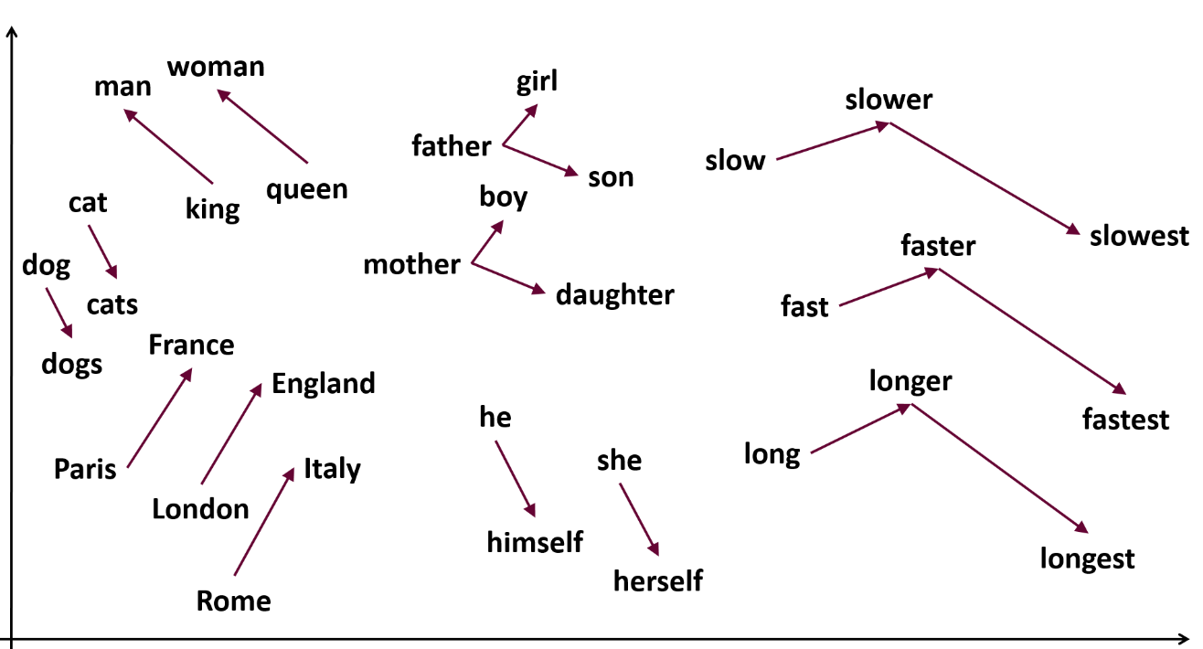
Word2vec
Word2Vec models are shallow, two-layer neural networks that are trained to reconstruct linguistic contexts of words. Similar words are located close to one another in the space. More dissimilar words are located farther from one another in the space.
We used one of the pretrained word2vec models: glove-wiki-gigaword-100 as our vectorizer but the performance is not that good, so we turned to train our customized word2vec model.

Slide 29
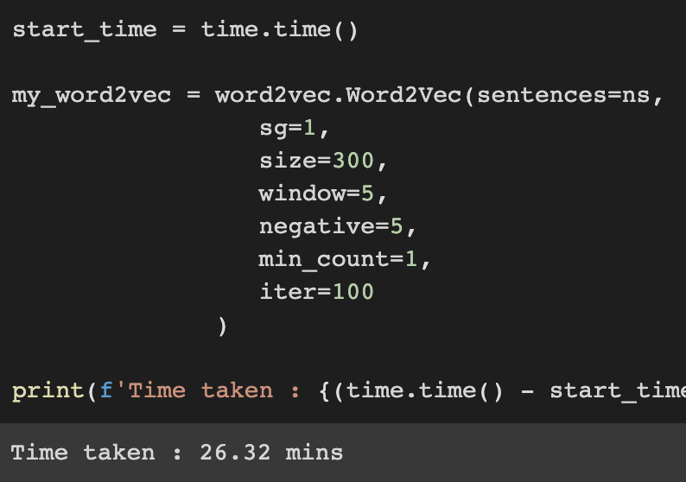
Custom Word2vec
To train a custom word2vec model, we need pack all our sentences into a list and set our feature size, here we set 300 as our size and since we have a small corpus, so we take every words into account even that word only show up once.
As we can see from the right screenshot it takes us around 26 mins to train the custom word2vec model.

Slide 30
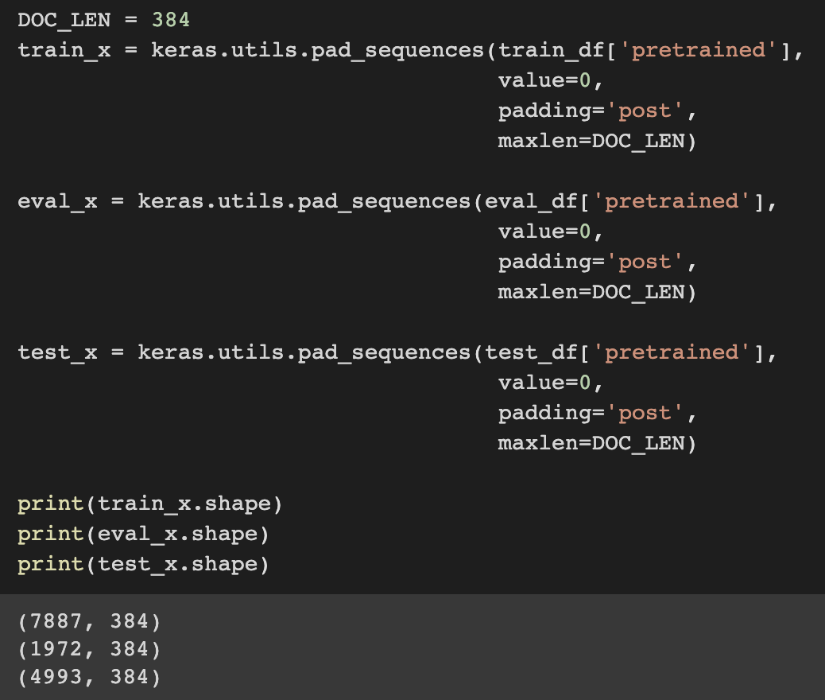
convolutional neural network
From the histogram we can see that most documents have a length less than 400. Also, we take 384 as our document length.

Slide 31
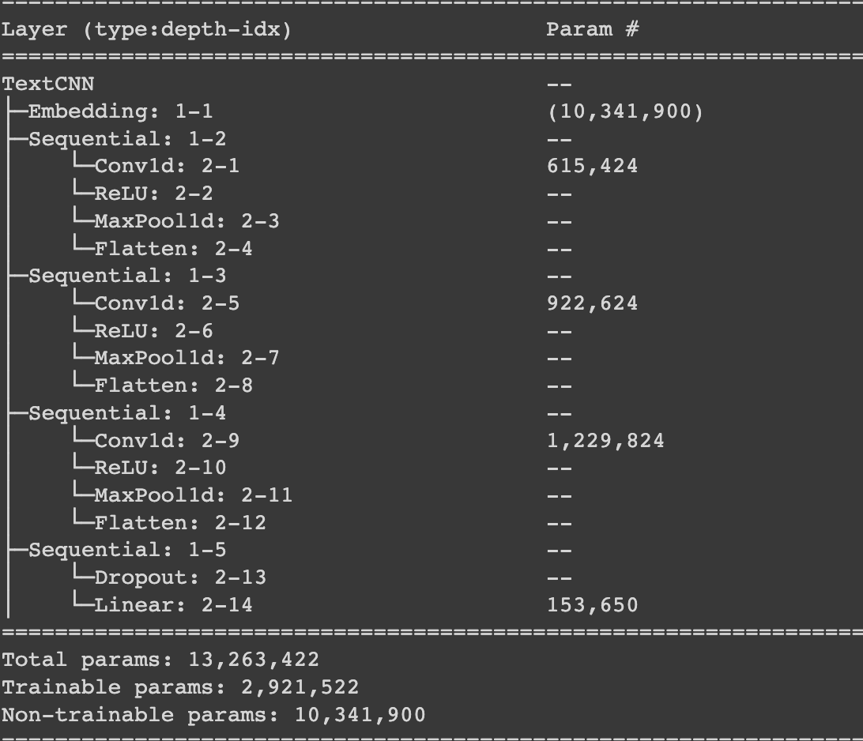
convolutional neural network
We first add an embedding layer to apply our custom word2vec model
Then build a CNN model with 3 layers and each one have 1024 units
Since we have 50 labels, so the output shape is 50.

Slide 32
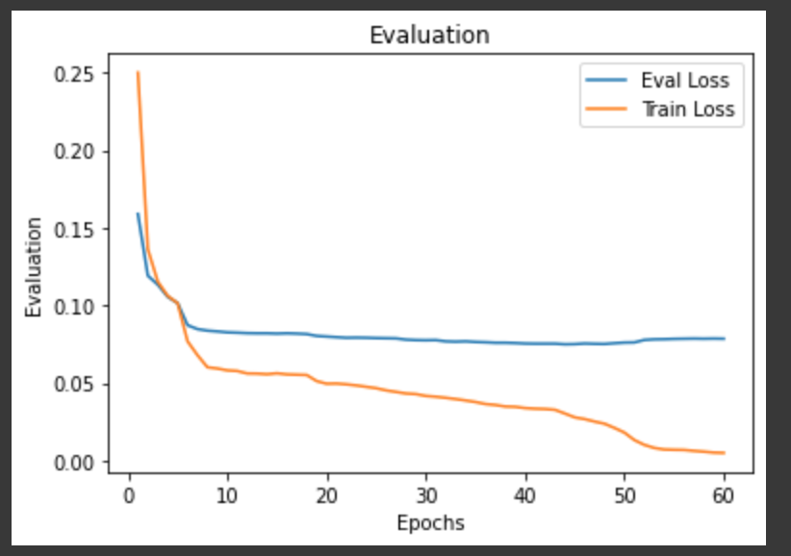
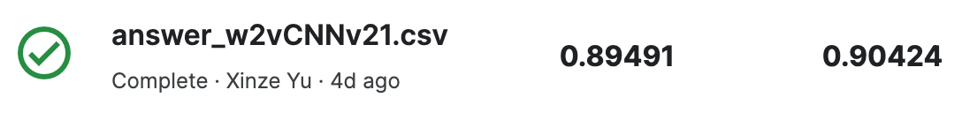
convolutional neural network
We trained in total 60 epochs, and the evaluation loss is no longer decrease at around 0.0751
And its final test accuracy is 0.90424

Slide 33
Deficiencies and Prospects
1. We think we can still improve on the text processing: in general, the title can better reflect the theme of the whole article, so we think that if the proportion of the title text in the whole text is increased, it may produce better results.
2.What if we use RNN(LSTM/GRU) instead of CNN model? Recurrent Neural Networks associates words that are far apart in the text, which is what CNN cannot do. Maybe an RNN can generate a better result.
3. Now that the results of our customized word2vec model training have been significantly improved, we are thinking, if we can use Bert to train a customized tokenizer and apply it to the Bert model, is it possible to improve the classification results?

Slide 34
THANKS FOR LISTENING!

